Slide 1

🏠 HOSTEL & FOOD
The Real College Life Begins Outside the Classroom
My experience • My tips • Your choices
Presented by: Nisarg Patel

Slide 2





🧳 My Home Away From Home
MY HOSTEL JOURNEY
Since 1st Year → Royal Care Hostel
Hostel taught me more than just academics:
Taking care of myself
Making new friends
Building connections with seniors
Becoming more independent
Learning to live with others
"You don't just live in a hostel… you grow here."

Slide 3
🤝 Life Becomes Easier Together
WHY HOSTEL / PG?
📚 Study Together
🤝 Learn Together
🚀 Grow Together
Journals • Assignments • Exams
Notes • Materials • Senior Guidance
Friends • Connections • Experiences
One room → Many experiences.

Slide 4


🌙 Nightouts? Freedom with Limits.
HOSTEL = FREEDOM + SECURITY
Hostel life gives you freedom, but safety comes first.
🔐 Hostel security & entry rules
⏰ Fixed timings / night restrictions
📞 Guardians & hostel management stay connected
👥 Going out with friends is easier when planned properly
Rules may feel restrictive… but they are there for your safety.

Slide 5
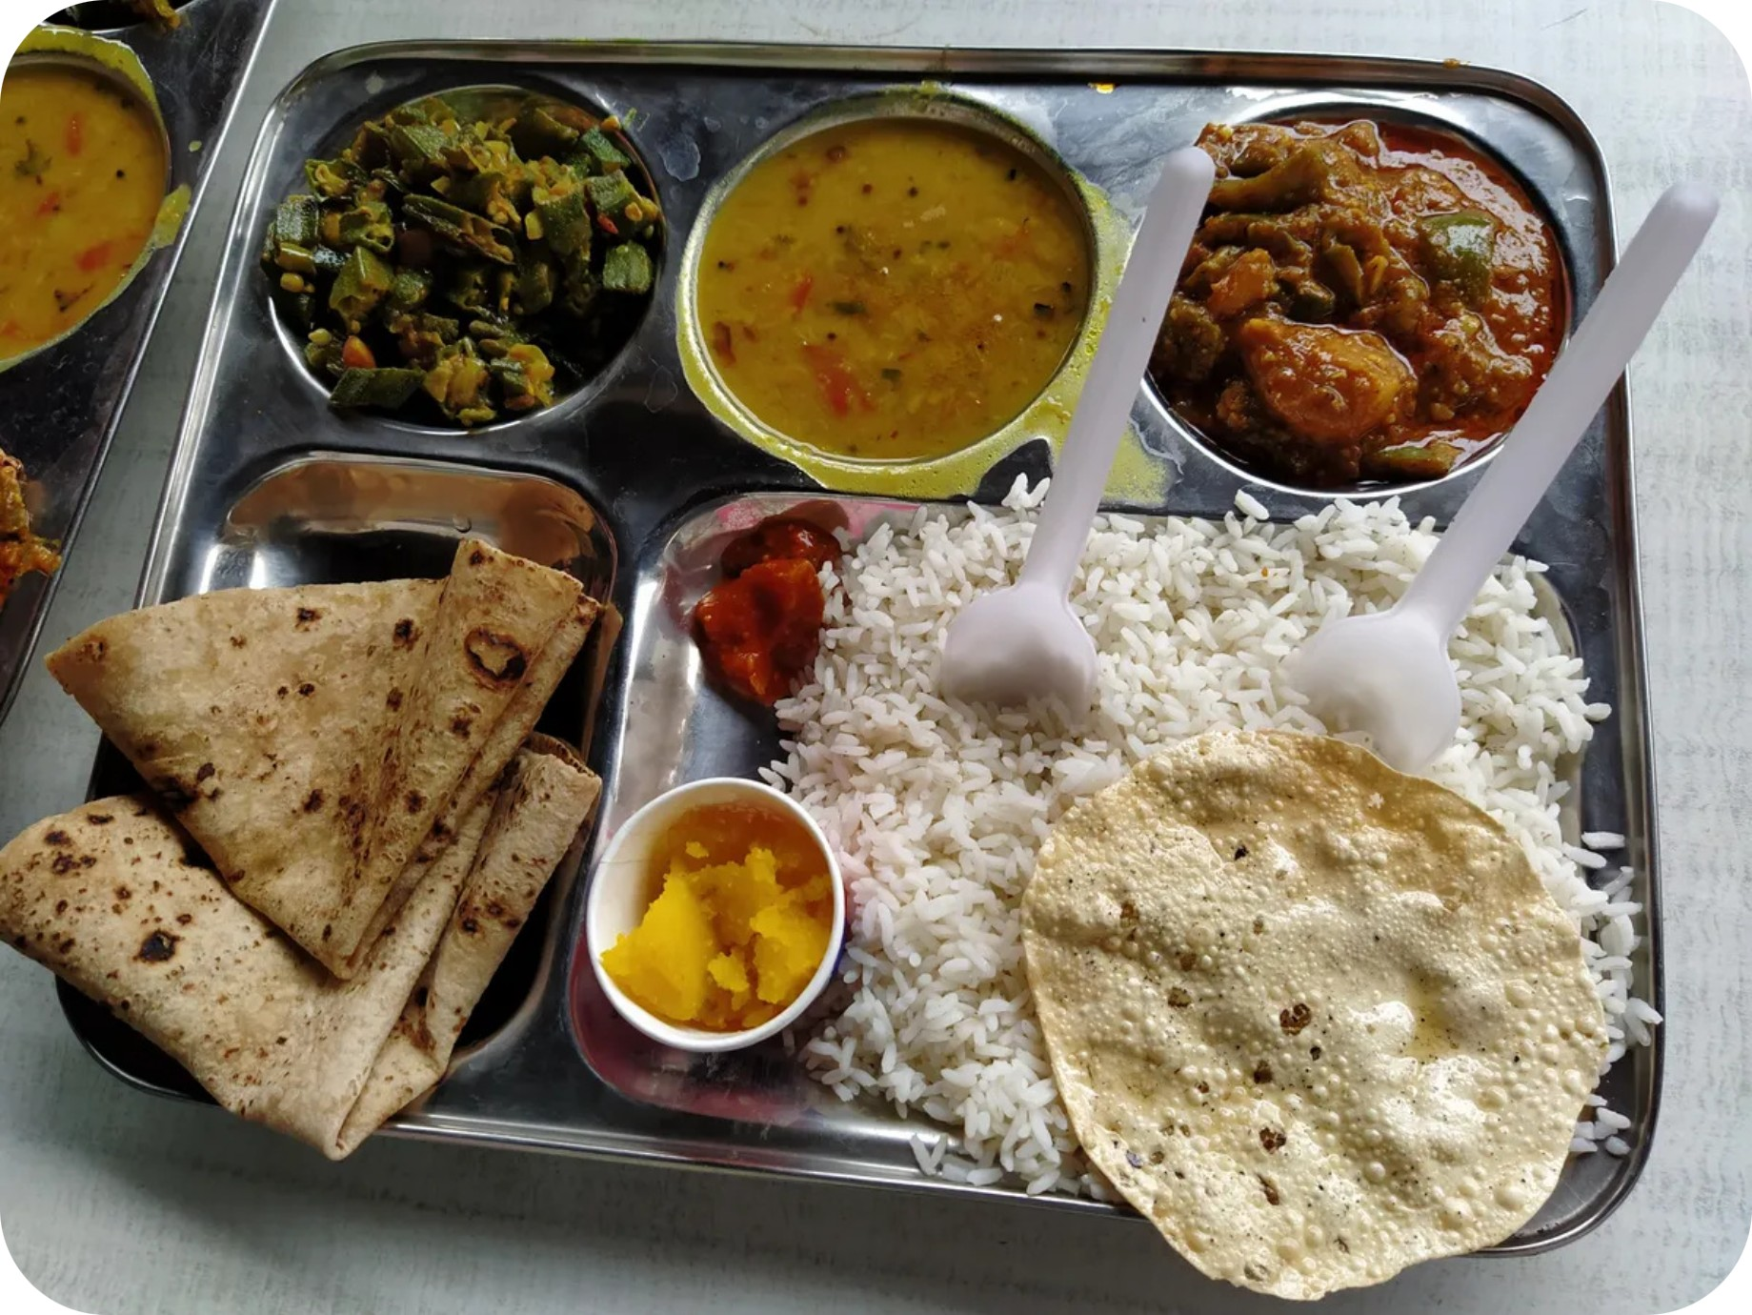
😋 "Aaj Khane Mein Kya Hai?"
FOOD 🍛
🏠 HOSTEL
Breakfast → Lunch → Dinner
Your meals are already planned.
✅ No daily food planning
✅ Saves time
✅ Fixed routine
✅ Food available at your place
Less thinking. More time for yourself.

Slide 6



🍕 PG = More Choices… More Decisions!
PG LIFE: THE DAILY FOOD QUESTION
Every day:
"Aaj kya khana hai?"
"Kahaan se khana hai?"
"Aaj khana hai ya nahi ?" 😂
You get more freedom with food… but sometimes freedom takes time.
🌮 And yes… Nadiad has options!
McDonald's
La Pino'z
Subway
Swad
Navjeevan
Dankawala

Slide 7







🚀 YOU ARE FREE!
THE BEST PART
Hostel/PG life gives you something new:
CHOICE.
You can…
📚 Study
💻 Learn new skills
🏋️ Go to the gym
🎹 Follow your hobbies
👥 Hang out with friends
🌆 Explore Nadiad
😴 Or simply take a break!
Your day = Your choice.

Slide 8
⚡ With Great Freedom Comes Responsibility
BUT REMEMBER…
You have 24 hours.
The question is not:
"How much free time do I have?"
⏱️ Manage your time.
🎯 Give priority to what matters.
The question is:
🚀 Enjoy college without losing your direction.
Study + Skills + Friends + Fun = College Life
"What am I doing with it?"

Slide 9






There Is No Fixed Template
College gives you the freedom to:
Try
Fail
Learn
Improve
It's completely okay if initial attempts don't go as planned:
Studying only from notes might yield unexpected results.
Last-minute preparation might not get the marks you wanted.
Trying a new skill might reveal it's not for you.
Your 1st Year is the best time to experiment, since 1st Year SPI doesn't count towards placements at DDU. Use this time wisely!
Find Your Sweet Spot
Adapt
Make Mistakes
Experiment
Explore

Slide 10

ENJOY THE FREEDOM. BUILD YOURSELF.
CONCLUSION
Independence
Friendships
Experiences
Growth
So…
Make sure that when you leave college, you take something much more valuable with you than just a degree. ❤️

Slide 11
LET'S CONNECT 🤝
Nisarg Patel
🔗 LinkedIn: linkedin.com/in/nisargpatel510
📱 Phone: +91-9427944293
Thank You!
Enjoy your College Life! 😄

